Slide 1
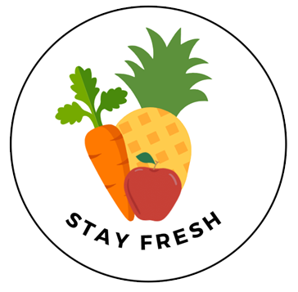
StayFresh Produce Management System
Amelia Mazer, Thao Nguyen, Swetha Sarma, Elyse Wu

Slide 2
CONTENTS
01 Our Company
02 Information System
System Request
Context Diagram
Program Structure Chart
03 Demo
04 Conclusion

Slide 3
StayFresh Company
StayFresh is a technology company that provides software solutions to restaurants of all sizes
Our mission is to help restaurants see data in new ways, discover insights, unlock endless possibilities, and improve sustainability in the restaurant industry.
We believe that it’s our responsibility to protect and preserve the environment for generations to come

Slide 4
Problem Statement
33 billion pounds of food waste are generated by US restaurants annually
$162 billion loss due to food waste
Due to the Coronavirus, 80,000 restaurants have temporarily or permanently closed.
⇒ Effective inventory management is a must
Notes:
The problem our company has identified is food waste. 33 billion pounds of food waste are generated by American restaurants annually. As a result, we see a $162 billion loss of revenue. And now, due to the Coronavirus, roughly 80,000 restaurants have closed for the time being or worse, permanently.
It is more important than ever for restaurants to manage their inventory effectively. It helps them keep the right amount of food and ingredients on hand to serve all customers and at the same time, avoid spoilage and loss. Restaurants are more likely to find long-term success if they practice effective inventory management.
Driven by our core mission to improve sustainability, we have developed a solution called, StayFresh Produce Management System to help restaurants combat this problem.

Slide 5
Business Need & Business Requirements
This project was started to help restaurants increase profit and decrease food wastage, while allowing our company to increase sales
Using StayFresh software, restaurants will be able to:
Monitor fresh produce inventory levels and pre-fill purchase order for low stock items
Monitor fresh produce expiration date and notify when items are about to expire
Connect the network of StayFresh restaurants with
food banks and allow for food donation matching
Notes:
This solution allows restaurants to effectively manage their fresh produce inventory and create a channel to redistribute excess food, thereby control food cost, increase profit margin, while also practicing food sustainability.

Slide 6
Business Value
We expect, with the implementation of our software:
Food waste and spoilage will reduce by 50% and donations of surplus food will increase by 100%
Restaurant’s social image will be enhanced by their donation partnership with food banks
Customer satisfaction will increase with fresher food

Slide 7
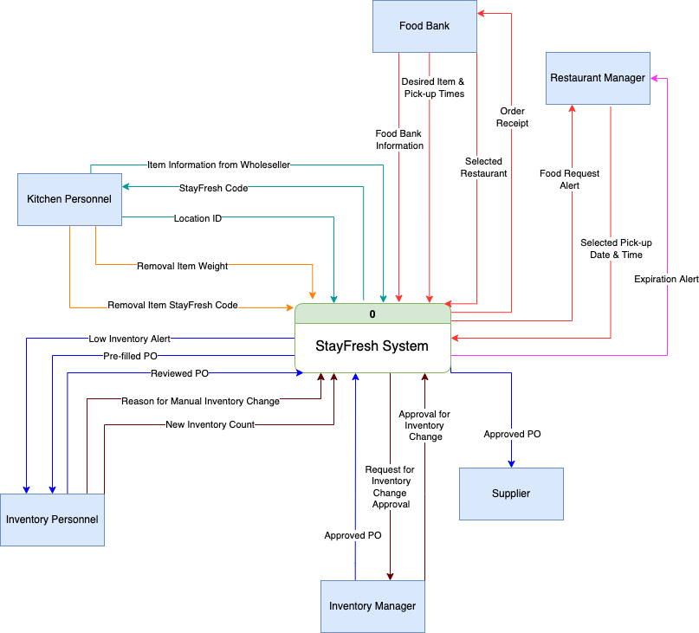
Context Diagram
Notes:
Our system is basically interact with 6 entities
Kitchen personnel - interact the system by checking fresh produce items in and out
Inventory personnel -
Inventory manager -
Restaurant manager -
Food bank -
Last but not least,

Slide 8
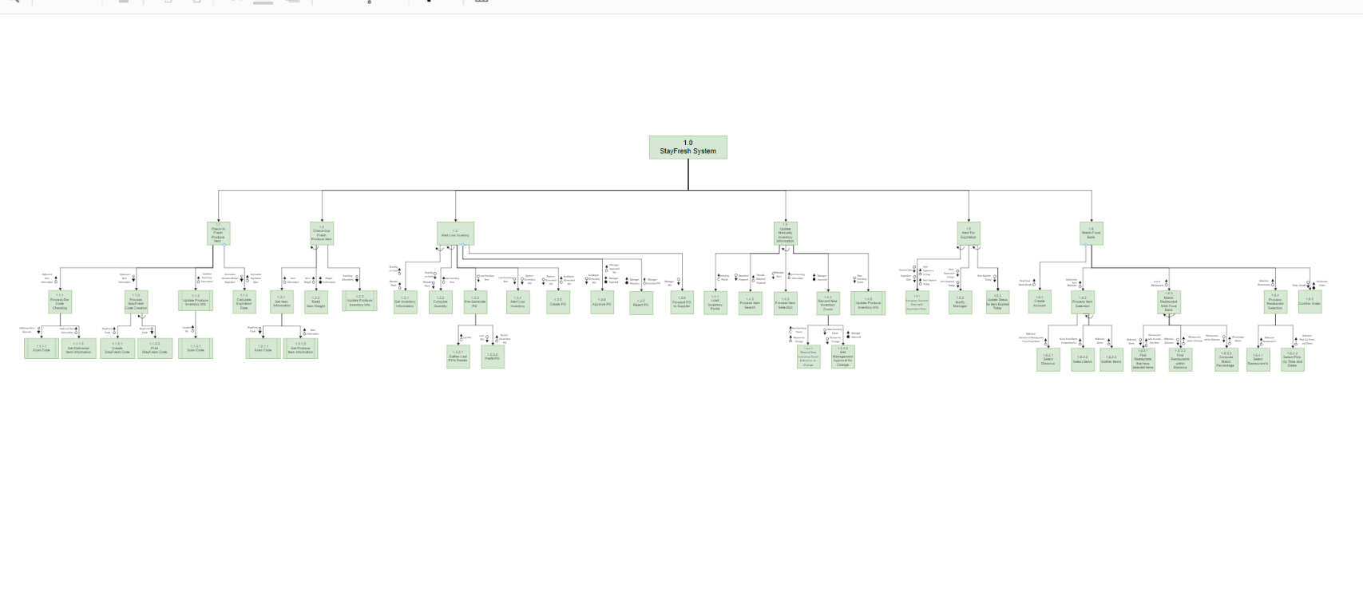
Program Structure Chart
1
2
3
4
We will break down the diagram in the following slides
Notes:
Here’s our structure chart, which is derived from our business requirements Amelia just talked about
In order for everyone to see it clearly, we will break down the diagram in the following slides

Slide 9
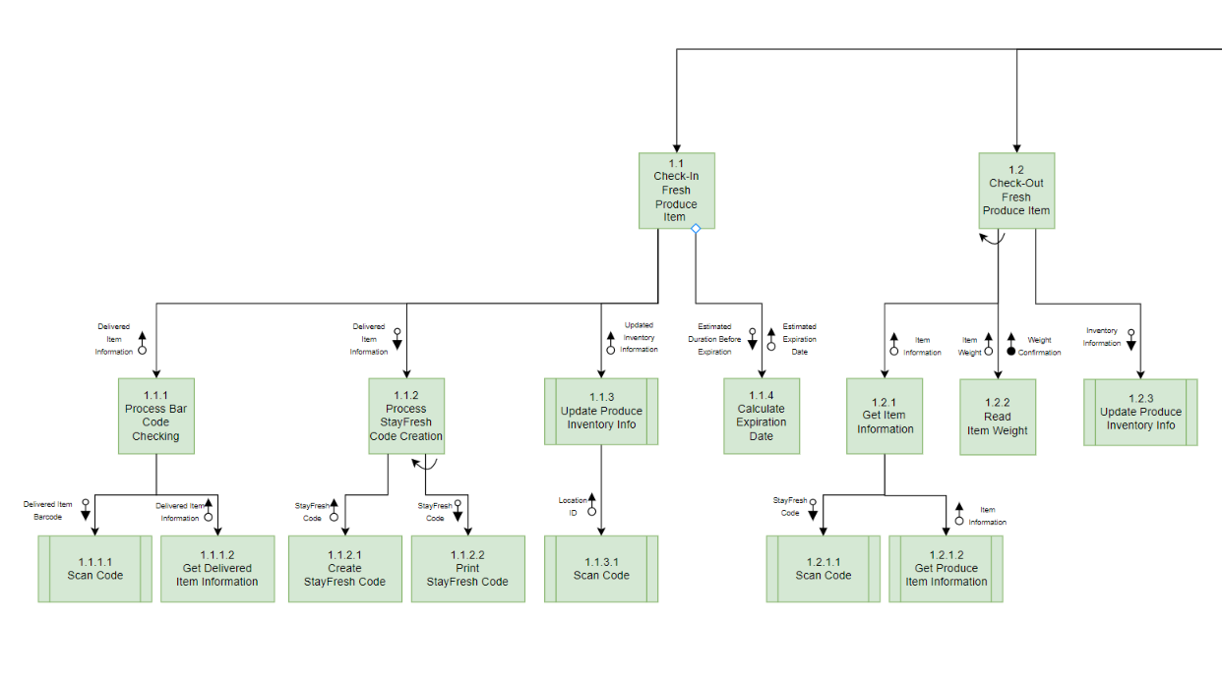
Program Structure 1

Slide 10
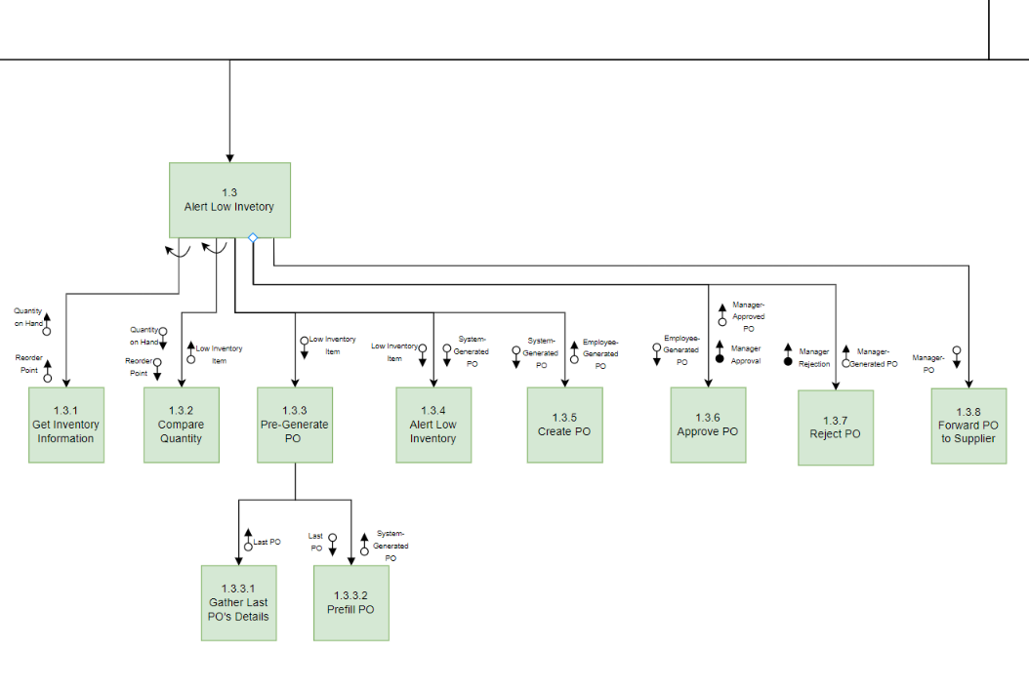
Program Structure 2
Notes:
Low inventory point

Slide 11
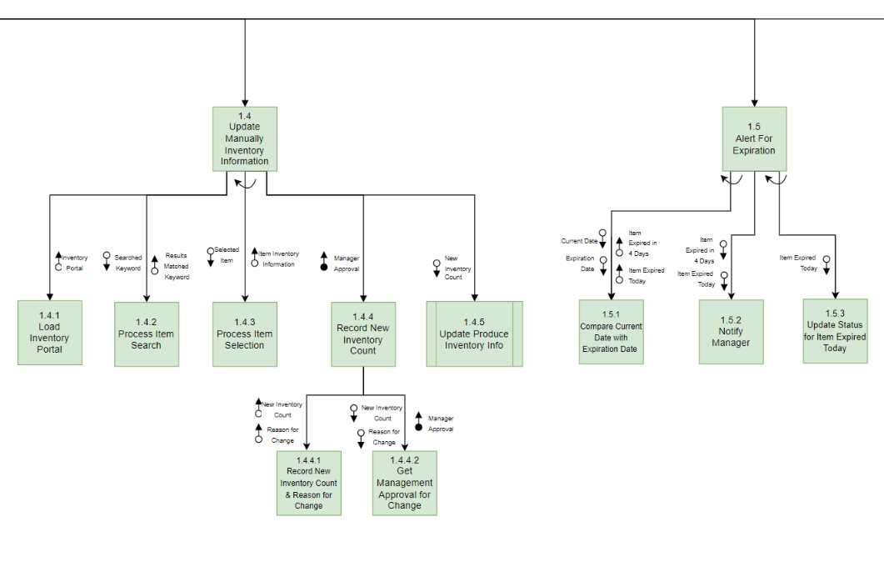
Program Structure 3

Slide 12
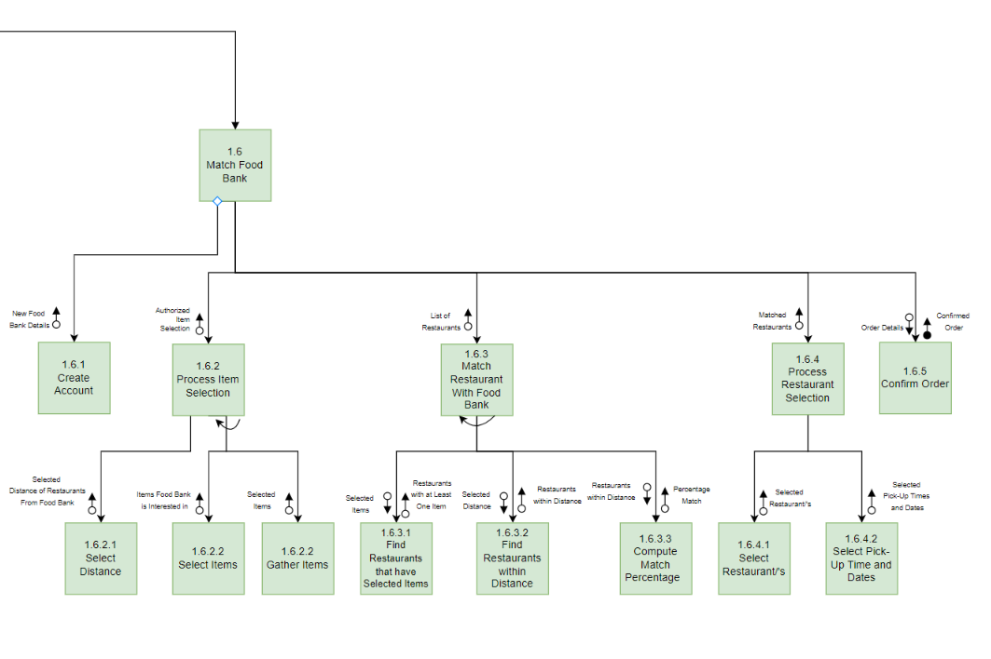
Program Structure 4
Notes:
One of the most valuable part of our system
for donatable items
Next, I’ll pass it to Swetha to demonstrate our system in detail

Slide 13
Demo
Notes:
Swetha → Lead into the Demo Starting with
Food Bank Interface
Employee Check In/ Check Out
Employee Management System

Slide 14
Conclusion & Future Directions
Conclusion:
One of our missions is to improve sustainability in the restaurant industry.
Our solution, allows restaurants to effectively manage their fresh produce inventory lifecycle and create a channel to re-distribute excess food.
Our solution helps restaurants control food cost, therefore increasing profit margin, while also practicing food sustainability.
We expect our solution to reduce a restaurant’s food waste by 50%, and allow it to donate 100% of surplus food.
Future Directions:
To use food sensors to precisely monitor fresh produce states
To include machine learning algorithms to predict more accurately the expiry dates
To expand the expiration management system to include all food products.
To upgrade the food donation system allowing restaurants to select donatable food directly from their data stores
Notes:
Conclusion
MIssion to improve sustainability in the restaurant industry.
Solution allows restaurants to manage their fresh produce inventory lifecycle.
Hopefully this can increase profit margins for restaurants and decrease food wastage
Our goals are reduce waste by 50% and donate the surplus of 100%
Future Directions:
Food sensors to better/more accurately monitor fresh produce status
Use ML techniques to predict more accurately when the fresh produce will expire
Expand our domain from fresh produce to other food products
upgrade the food donation system to allow restaurants to select donatable items directly from the datastore.

Slide 15
Thank You

